Slide 1
ETL – extract transform and load, and Data Quality http://docs.oracle.com/cd/B19306_01/server.102/b14223/ettover.htm#CEGJGJBD part 1

Slide 2
ETL
Data Integration
  Choosing the data required
Data Extraction
  From original sources
Data Quality Checks
Data Transformations
Data Load – into the DW

Slide 3
Data Structure Types
Structured Unstructured
Relational Databases data
- XML data
- Data warehouses data
- Enterprise systems
that holds data such as CRM,
ERP, etc
Data in Excel spreadsheets
- Data in Word documents
- Email messages
- RSS feeds
- Audio files
- Video files
FB data
Twitter data
Satelite data

Slide 4
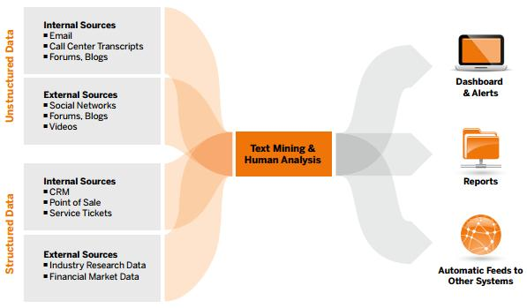
Structured vs. Unstructured Data
http://www.datasciencecentral.com

Slide 5
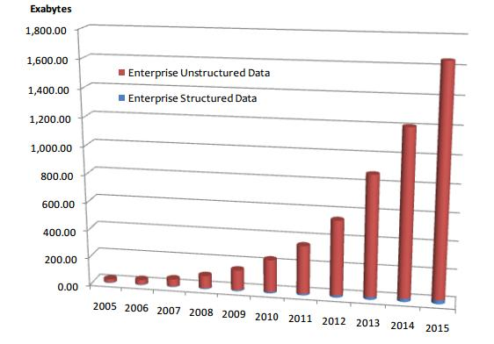
Structured vs. Unstructured Data
http://www.datasciencecentral.com

Slide 6
Problems with data: Structured data
Exercise
On the hand-out, list what problems there are with data provided by the given operational data…
….

Slide 7
Data Quality Topics
Data structures
Quality Data
Problems with Data
Poor Data Quality
Improving Data Quality
Data Dictionary
Performace

Slide 8
Problems with Data
PROBLEM SOLUTION
Inaccurate Accurate
Irrelevant In context
Out of date Timely, current
Inconsistent Consistent
Invalid Valid
Unclear Unambiguous
Incomplete Comprehensive

Slide 9
Causes of Data Quality Problems
Users
Poor training
Lack of controls and data validation
Bad systems design & programming
Heterogeneous data sources
Lack of metadata for Legacy systems
External data sources
Poor understanding of user requirements
Data transmission
System unreliability/failures
Notes:
Users
Sloppy data entry/lack of care or interest
Poor training
Users unsure what is needed at point of entry
Lack of controls and data validation
Little or no data validation or pick boxes etc
Bad systems design & programming
Input form poorly designed giving user doubts as to what is being asked
Heterogeneous data sources
Data coming from many different data sources
Lack of metadata for Legacy systems
Data in legacy systems not documented and hence data difficult to interpret
External data sources
data could come from other peoples' systems and hence difficult to understand
Poor understanding of user requirements
Systems analysis was poor and hence software/database inadequate
Data transmission
Corruption or faults in data transmission from source systems
System unreliability/failures
Corruptions/missing data due to system faults etc

Slide 10
Quality Data has:
Content
  relevant, obtainable, clearly defined
Scope - comprehensive & essentialness
Level of detail
  granularity & precision of domain
Accuracy - correct, in itself & to other data
Currency - timely, current
Consistency - correctness of data values

Slide 11
Poor Data Quality
is pervasive, i.e. it spreads - GIGO
is costly
  loses customers & adds expense
  makes using new technologies more difficult
    e.g. data warehousing
causes employee dis-satisfaction
breeds organisational mistrust
Data Quality can be improved

Slide 12
Improving Data Quality (1)
Correct data with poor quality
  scrubbing or cleaning
Compare to the real world - expensive
Compare to other database (database bashing)
Data Edits (rules to apply to an existing database)
All are Inspection & rework improvement methods and are therefore costly
Better to collect & input data correctly
  use integrity measures from the beginning

Slide 13
Improving Data Quality (2)
Design systems (not necessarily computerised) that maintain data quality
SIM methods to ensure data quality upon input
  Tables, fields, data types & sizes
  Relationships & referential integrity
  Cascade update & delete
  Validation rules, input masks, default values
  List & combo boxes

Slide 14
Improving Data Quality (3)
Ensure all staff understand:
  their roles & responsibilities in terms of data quality
  the data they are using and how it should be used, and will be used by others
  the limitations of the data they are using
  the systems they are using and how they should be used
In short, train them well

Slide 15
Improving Data Quality (4)
Initiate a Data Quality Program
Focus on the most important data
Meet the needs of customers, external & internal
Identify sustainable gains, preferably measurable (Auditable)
Clearly define management responsibilities, for improvements & program admin

Slide 16
Data Quality Program
4 interrelated components
  Clear business direction, objectives & goals
  Management infrastructure that assigns responsibilities for data and providing the tools to succeed – Data Protection Act
  Operational plan for improvement, which methods for which data
  Program admin, monitor & ensure progress

Slide 17
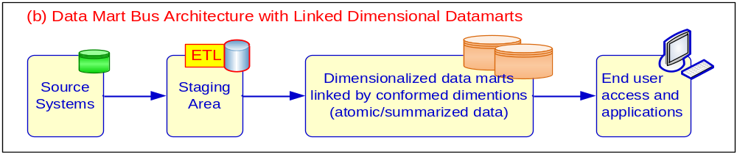
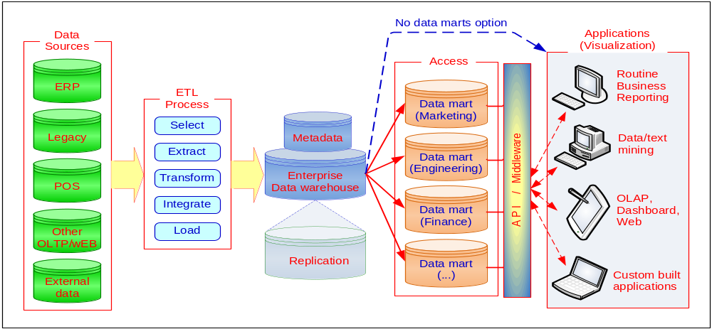
A Conceptual Framework for DW

Slide 18
Data Mart - Star Schema Example
time
time_key
quarter
Agent
Sales Fact Table
A_key
A_name
time_key
Agent_key
branch_key
branch
Customer
Customer_key
branch_key
branch_name
C_key
Cname
total_orders
totalOrderCust
totalOrderAgent
Measures

Slide 19
Data Staging Area
Storage area (aka Operational Datastore)
Processes and transforms data for use in DW (or in our case the Data Mart)

Slide 20
Cleansing
Agree standardised format
Identify highest quality system
Fix problems at source, if possible
Use Data Cleansing tools
Notes:
DC tools also known as data scrubbing these use such things a pattern recognition .

Slide 21
Transformation
Map source data to DW structures
Record level
    Selection
    Joining
    Aggregation
Field level
    Basic
    Algorithmic
    Look-up
Notes:
Need to transform data from the format in the post cleansed source data into the DW data structures.
Data cleansing is about correcting errors / inconsistencies in data – transformation is about converting the data format – there is a blurring of the edges between these two processes.
1 process of partitioning data according to predefined criteria. Many data captures are incremental, so if the source is relational, a SELECT statement will be used to query the cleansed after image extract from a log file possibly using a where clause on the date to extract records after a certain date.
2 Combine data from various sources into a single table or view – simply use SQL joins if the source is relational. May need to reconcile primary keys from different sources. Can be problematic if the source data is not fully cleansed – I.e. attempting to join on inconsistent key values.
3 detailed level to summary level.
Algorithmic – e.g. convert Fahrenheit to Celsius
Look up – e,g, convert County code to County name
INSERT FIRST WHEN cust_credit_limit >= 4500 THEN INTO customers INTO customers_special VALUES (cust_id, cust_credit_limit) ELSE INTO customers SELECT * FROM customers_new;

Slide 22
OLTP emp table
NAME | STREET | CITY | STATE | ZIP | DEAR WHO | TEL HOME | BIRTH DATE | HIRE DATE | INSIDE
Guiles, Makenzie | 145 Meadowview Road | South Hadley | MA | 01075 | Macy | (413)555-6225 | 19770201 | 20060703 | yes
Forbes, Andrew | 12 Yarmouth Drive | Holyoke | MA | 01040 | Andy | (413)555-8863 | 19600330 | 20060710 | yes
Barra, Alexander | 4327 Spring Drive | Sandwich | MA | 02537 | Al | (508)555-8974 | 19861221 | 20060717 | no
Mellon, Philip | 123 Pendexter Street | Boston | MA | 01321 | Phil | (781)555-4289 | 19700625 | 20060724 | no
Clark, Pamela | 44 Mayberry Circle | Bedford | MA | 01730 | Pam | (860)555-6447 | 19500502 | 20060731 | yes
Notes:
Convert the dates from CCYYMMDD into CCYY-MM-DD
Split the first and last names
Assign the manager based on inside or external sales
Map the data to the new schema

Slide 23
Data AFTER pre-processing/cleaning
new_empl.dbf
Emplo yeeID | Last Name | First Name | Title | TitleOf Courtesy | BirthDate | HireDate | Address | City | Reg ion | Postal Code | Coun try | HomePhone | Exten sion | Notes | Repo rtsTo | Photo Path
10 | Guiles | Makenzie |  | Macy | 1977-02-01 00:00:00.0 | 2006-07-03 00:00:00.0 | 145 Meadowview Road | South Hadley | MA | 01075 | USA | (413)555-6225 |  |  | 8
11 | Forbes | Andrew |  | Andy | 1960-03-30 00:00:00.0 | 2006-07-10 00:00:00.0 | 12 Yarmouth Drive | Holyoke | MA | 01040 | USA | (413)555-8863 |  |  | 8
12 | Barra | Alexander |  | Al | 1986-12-21 00:00:00.0 | 2006-07-17 00:00:00.0 | 4327 Spring Drive | Sandwich | MA | 02537 | USA | (508)555-8974 |  |  | 5
13 | Mellon | Philip |  | Phil | 1970-06-25 00:00:00.0 | 2006-07-24 00:00:00.0 | 123 Pendexter Street | Boston | MA | 01321 | USA | (781)555-4289 |  |  | 5
14 | Clark | Pamela |  | Pam | 1950-05-02 00:00:00.0 | 2006-07-31 00:00:00.0 | 44 Mayberry Circle | Bedford | MA | 01730 | USA | (860)555-6447 |  |  | 8
Notes:
(Titles split to make the display fit better)

Slide 24
Load and Index
Refresh – bulk rewriting at periodic intervals
Update – only source data changes are written
Indexing – bit-mapping is most commonly used.
Notes:
Refresh used with static data capture – most commonly used when creating a DW
Update used without overwriting or updating existing DW records.

Slide 25
ETL data integration exercise
Emp and Dept
(very simplified)
From operational tables (emp and dept) -> to a Data Mart with star schema model tables (time_dim, dept_dim and fact_emp)
Watch videos of this
In tutorial we will do a similar exercise

Slide 26
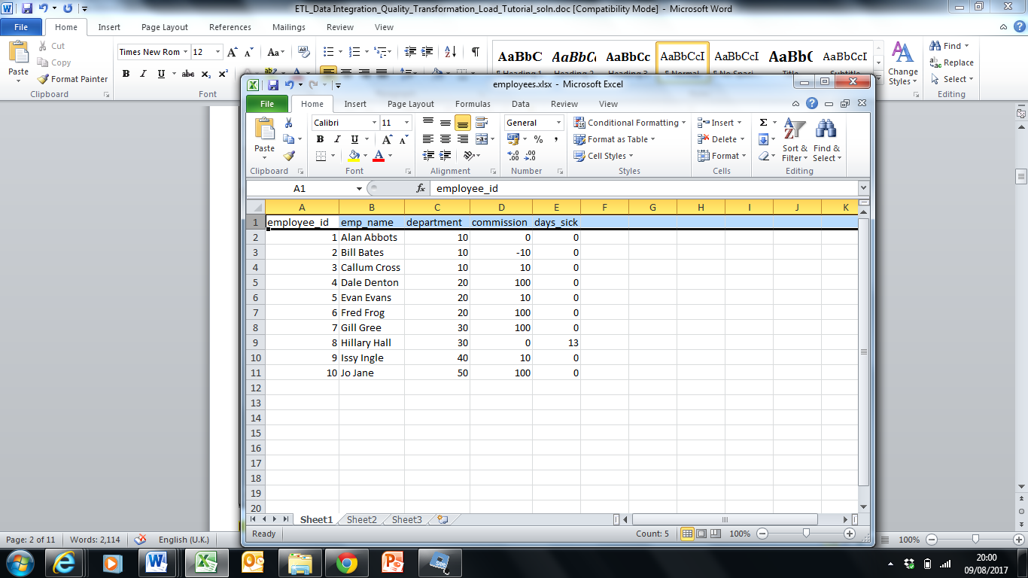
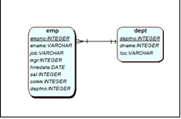

Employee db
emps_data.xls

Slide 27
Design a star schema to support:
No of employees per department per year
No of employees in 1980
No of employees in 1981

Slide 28
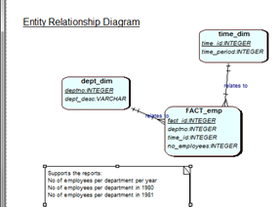

Slide 29
Data in the star schema tables - handout
In apex:
Time dimension – where is the data coming from? What is the data?
Dept dimension – what is the data?
Emp_fact – what is the data?
See mybeckett for solution and video including code.
This ‘play around code’ is in the notes of this slide
Notes:
-- this is 'play around' code to explore the data
-- Data for time dimension
SELECT * FROM emp
SELECT DISTINCT hiredate FROM emp
SELECT DISTINCT '19'||to_number(to_char(emp.hiredate,'YYYY')) FROM emp
-- What about the emps spreadsheet???
-- data for dept dimension
SELECT deptno, dname FROM dept
-- What about the emps spreadsheet???
-- data for fact table
SELECT empno, deptno, '19'|| to_number(to_char(emp.hiredate,'YYYY')) as which_year FROM emp;
-- How many employees in dept 20 in 1980
SELECT empno, deptno, '19'|| to_number(to_char(emp.hiredate,'YYYY')) as which_year FROM emp WHERE '19'|| to_number(to_char(emp.hiredate,'YYYY')) = '1981'
AND deptno = 30;
-- data for fact table - via series of steps
DROP table tmp_emp1;
CREATE TABLE tmp_emp1 AS
SELECT empno, deptno, '19'|| to_number(to_char(emp.hiredate,'YYYY')) as which_year FROM emp;
-- Lets see whats in tmp_emp1
-- this looks like a table we can now count the number of employees per department per year
SELECT * FROM tmp_emp1;
DROP table tmp_emp2;
CREATE TABLE tmp_emp2 AS
SELECT which_year, deptno, COUNT(*) no_of_emps FROM tmp_emp1 GROUP by which_year, deptno;
-- look at results, not this is pretty much the report we want - no of employees per year per department
SELECT * FROM tmp_emp2;
-- now we would like a report_id, a surrogate PK on the fact table - so use a sequence
DROP sequence fact_seq;
create sequence FACT_SEQ
start with 1
increment by 1
maxvalue 10000
minvalue 1;
-- this will only work as part of the complete solution to insert the data into the SS tables (see online video for code and solution)
-- as we have not created the ss tables at this point
INSERT INTO FACT_emp (fact_id, deptno, time_id, no_employees)
SELECT fact_seq.nextval, deptno, time_dim.time_id, no_of_emps FROM tmp_emp2, time_dim WHERE tmp_emp2.which_year = time_dim.time_period;
-- check the results
SELECT * FROM fact_emp;

Slide 30
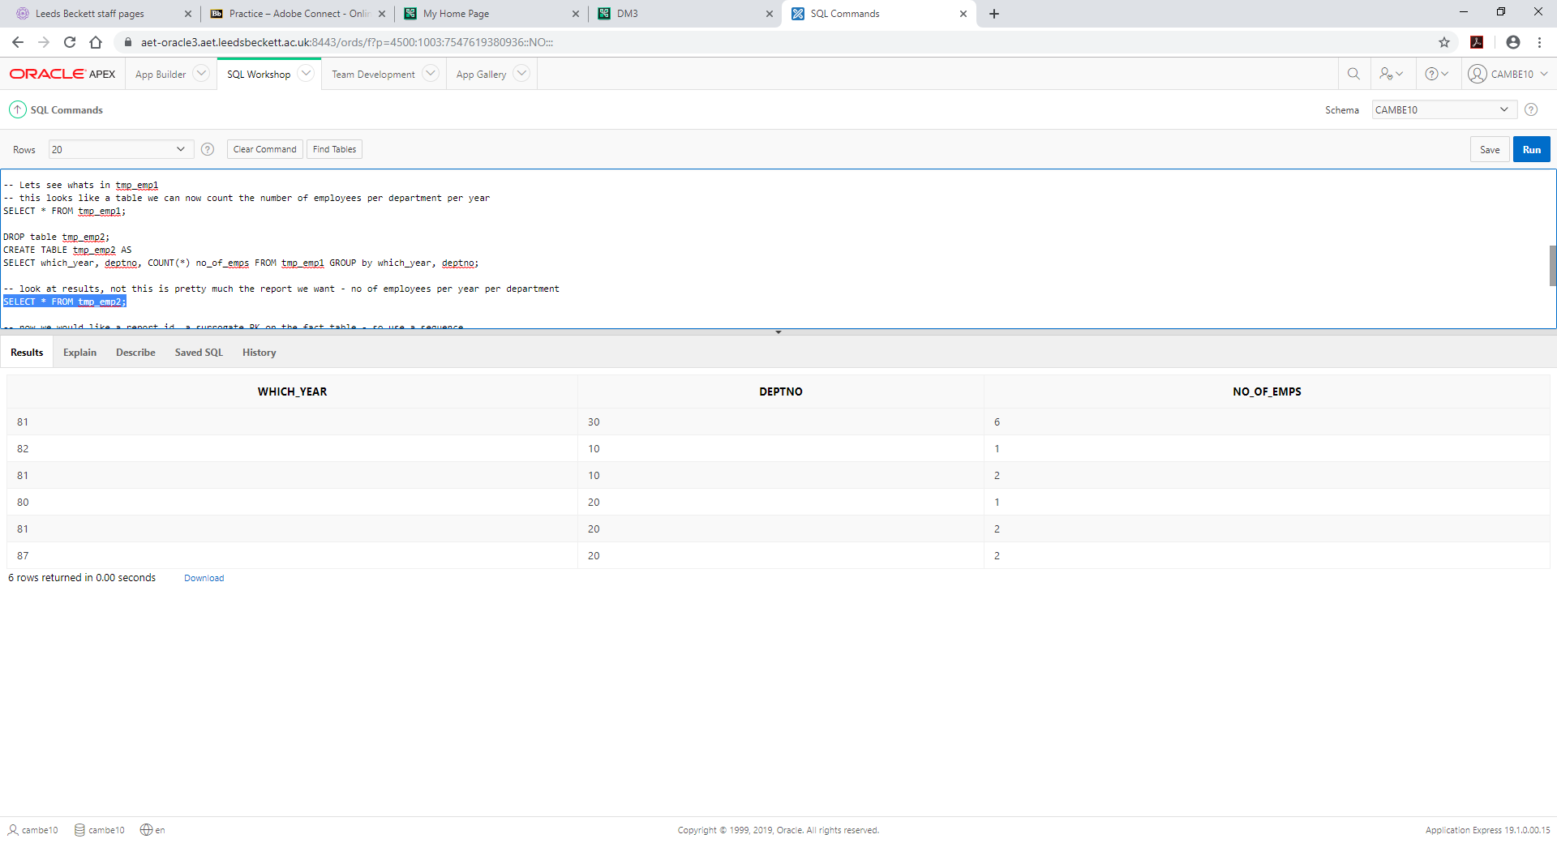

Slide 31
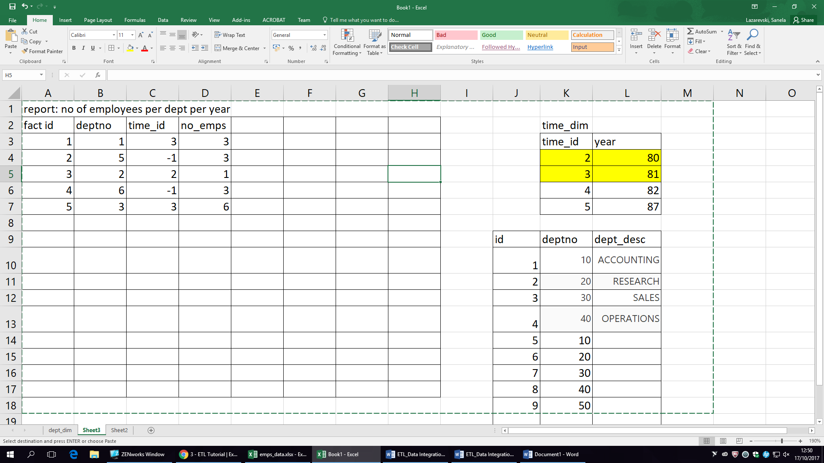

Slide 32
Tutorial : Data Integration

Slide 33
References & Reading
Data Quality for the Information Age
  T. C. Redman
  Artech House, Boston, 1996
Management Information Systems for the Information Age
  Haag, Cummings & Dawkins
  Irwin/McGraw-Hill, Boston, 1998
Look for books with good glossaries
  as both of these have
Good site on Accuracy of Data
  http://www.ccsr.cse.dmu.ac.uk/resources/professionalism/accuracy/
  Information Management website – how business works
  http://www.information-management.com/channels/data-quality.html

